Slide 1
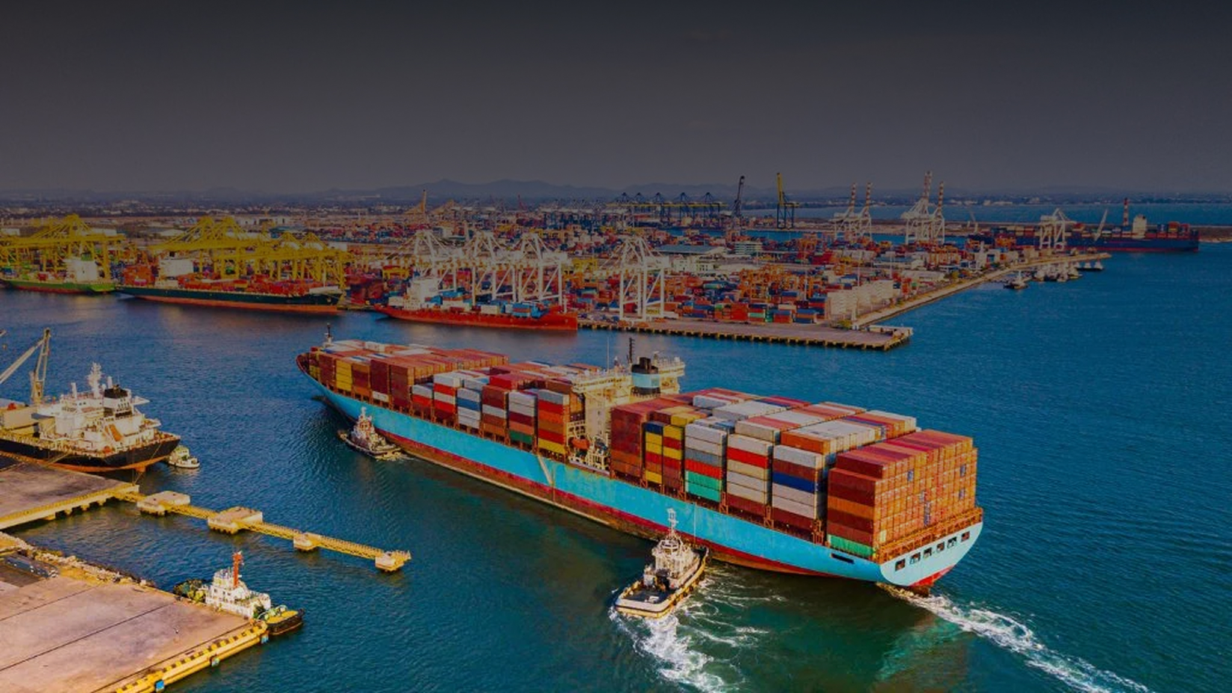

2025
Seamless Freight, Swift Clearance

Slide 2



01
About Us
Fastrack Freight Services is a complete logistics provider, offering specialized freight services, express parcel solutions, and international trade expertise.
With over three decades of industry experience, we have evolved into a trusted name in logistics, ensuring seamless and timely deliveries.
Our core focus is on Express Parcels, E-commerce Logistics, and International Freight Solutions, making global trade easier for our clients.
Key Highlights
30+ years of expertise in logistics & freight solutions
Specializing in Express Parcels, E-commerce, and International Freight
Dedicated to efficiency, compliance, and customer satisfaction

Slide 3



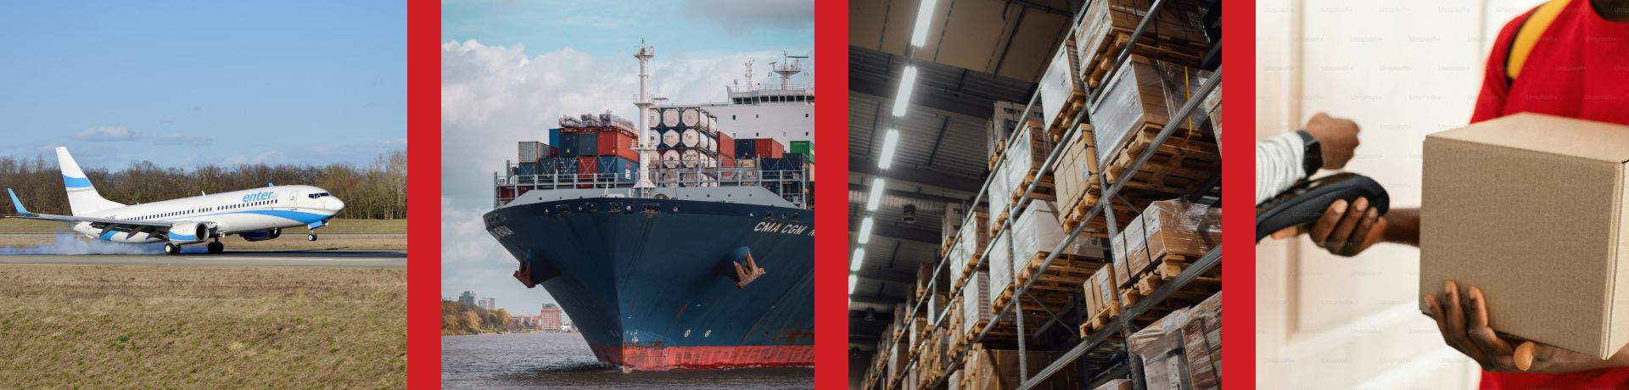
02
Services We Offer
Express Parcel Service
E-commerce Logistics
International Freight
Fast, secure, and reliable parcel deliveries
for domestic and international
Seamless shipping solutions for online businesses.
Efficient global shipping & trade compliance.

Slide 4



02.2
Services We Offer
Custom Clearance
(Import & Export)
Freight Forwarding
Project Cargo & Used
Machinery Clearance
End-to-end shipment handling worldwide.
Hassle-free customs processing.
Specialized handling & documentation.
Liaisoning Services
Warehousing & Distribution
Trade Consultancy
Coordination with state/central government bodies.
Safe storage & optimized supply chain.
Expert guidance on logistics regulations & trade policies.

Slide 5




03
Why Choose Us?
Decades of Experience
Customer-Centric Approach
Commitment to Timely Delivery
End-to-End Logistics Solutions
Fast & Reliable Express Services
Strong Industry Network
E-commerce & International Specialists

Slide 6

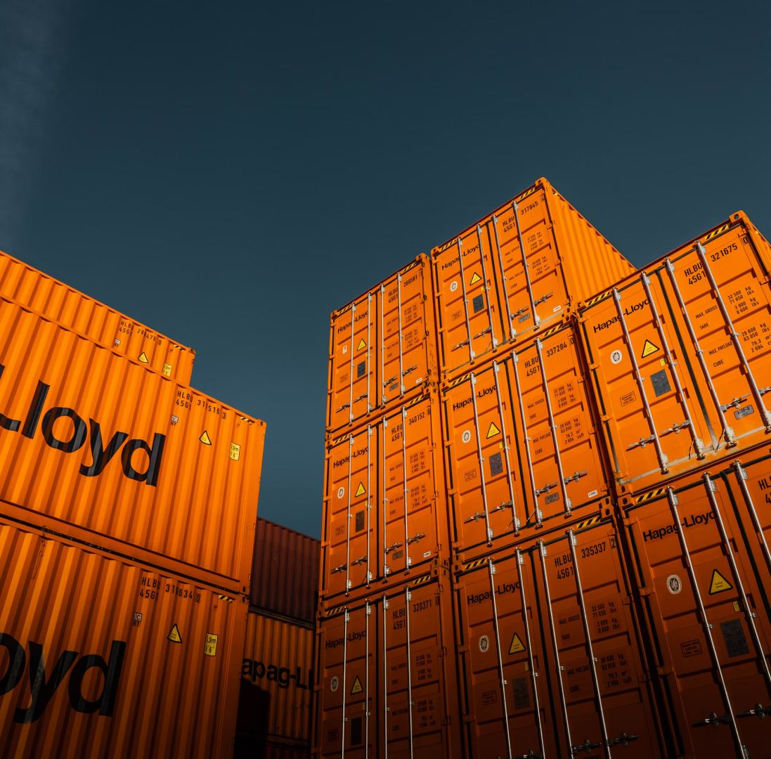


04
Our Clients
Trusted by leading businesses in logistics, e-commerce, and trade.

Slide 7
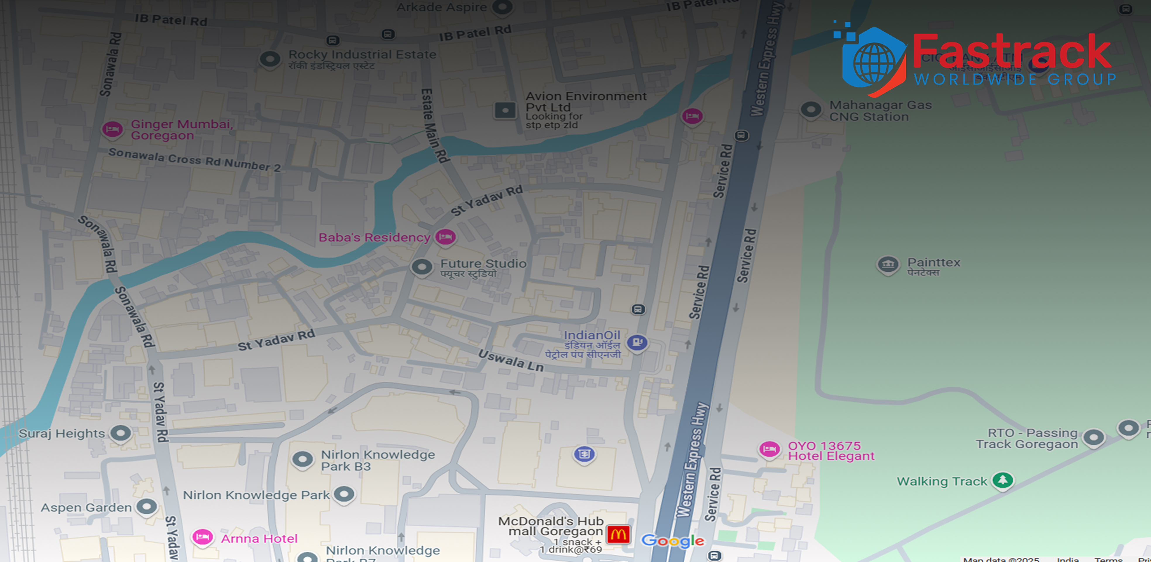



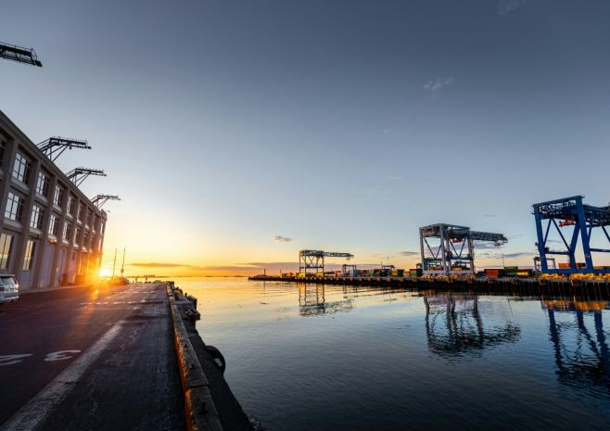

06
Contact Us
For follow-up inquiries, please reach out to us via the following channels
We look forward to connecting with you!
Address
Address
Corporate Office – 126, Nigos Building, Cama Road no 2, Near Indian petrol pump, Goregaon East, Mumbai 400063
Cargo Branch Office – Fastrack Freight Services, 12, A1, Vidyadhani Building, Om Nagar, JB Nagar, Andheri East, Mumbai 400099
Phone
E-mail
Website
+91 93731 59317
vikas@fastrackworldwide.com
www.fastrackworldwide.com

